Slide 1
A Dynamical Systems Approach to Neuromorphic Computation of Conditional Probabilities
Nigel Stepp (presenter) & Aruna Jammalamadaka
ndstepp@hrl.com
Information & Systems Sciences Laboratory
HRL Laboratories
Malibu, CA

Slide 2
Why Neuromorphic Bayesian Inference?
Complicated System
Interactions Known
?
?
Learning
Phase
?
?
Readout Phase
Probabilistic prediction of events for current conditions
“What if” questions about part replacement
“What if” questions about control actions
Need to measure probabilistic data and perform probabilistic computations.
Applications like Fault Diagnostics must be Scalable and Efficient.

Slide 3
Spike-Timing Dependent Plasticity
Spike-Timing Dependent Plasticity (STDP):
Connections that cause correlated spikes are strengthened
Connections that cause uncorrelated spikes are weakened
Computations occur due to single spikes, on the order of a few milli- or even microseconds.
“Pre” neuron
A
+
+
-
-
“Post” neuron
B
Time
Spikes (and STDP) allow for very small computations

Slide 4

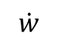
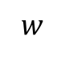
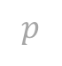
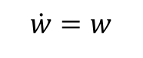
Developing a Probabilistic Computation Unit (PCU)
As an initial step, we want to show that synaptic weights in the Latigo chip can model the conditional probability between two random variables
Hypothesis: STDP and spike delays combine to create a conditional probabilistic computation unit
We want synaptic weight w to converge to a value p
i.e. we want w updates to have a fixed-point at p
$$\dot{w}$$
$$\dot{w}=w$$
$$p$$
$$w$$
A causes B to spike, resulting in an increase to w
We want STDP to implement a simple dynamical system

Slide 5
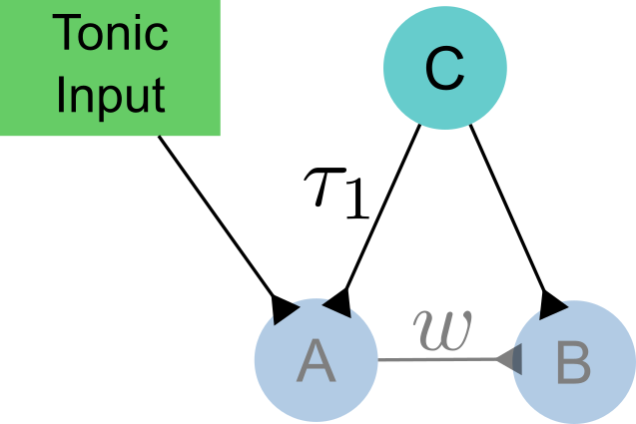

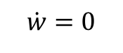
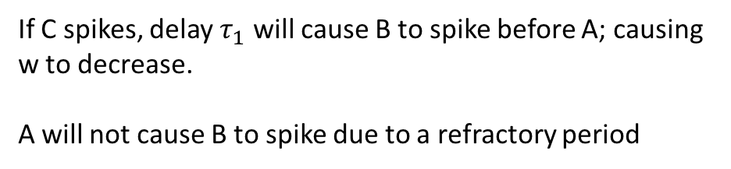
Developing a Probabilistic Computation Unit (PCU)
As an initial step, we want to show that synaptic weights in the Latigo chip can model the conditional probability between two random variables
Hypothesis: STDP and spike delays combine to create a conditional probabilistic computation unit
$$\dot{w}$$
$$\dot{w}=0$$
$$p$$
If C spikes, delay $τ_{1}$ will cause B to spike before A; causing w to decrease.
A will not cause B to spike due to a refractory period
$$w$$
Delayed feedback leads to exponential decay

Slide 6
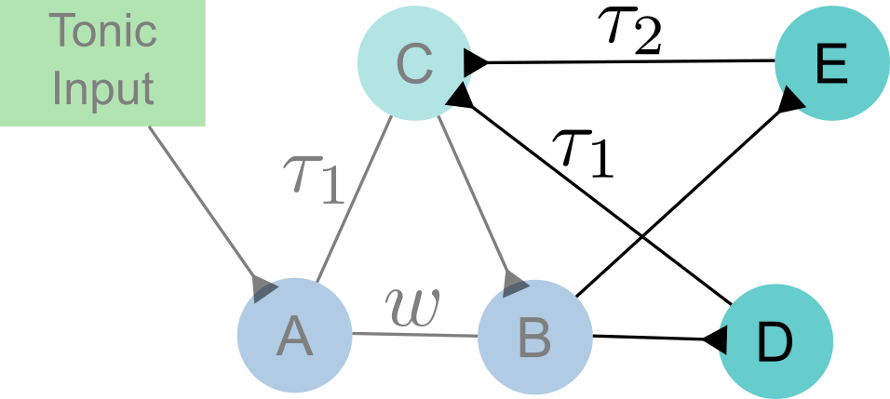
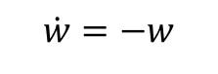
Developing a Probabilistic Computation Unit (PCU)
As an initial step, we want to show that synaptic weights in the Latigo chip can model the conditional probability between two random variables
Hypothesis: STDP and spike delays combine to create a conditional probabilistic computation unit
$$\dot{w}$$
$$\dot{w}=−w$$
$$p$$
Now B will cause C to spike twice
- Once through D (fast path)
- Once through E (slow path)
Result: w decreases in proportion to itself
$$w$$
Delayed feedback leads to exponential decay

Slide 7
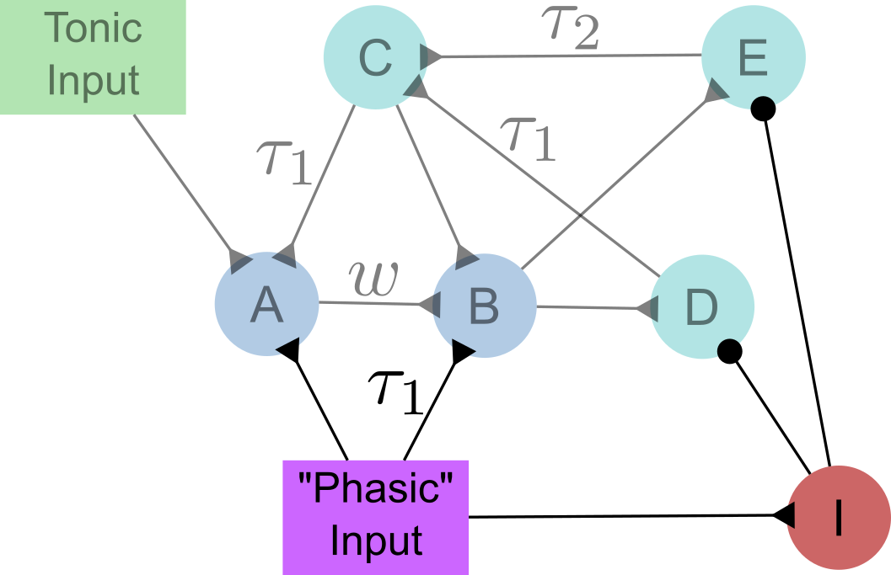
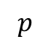
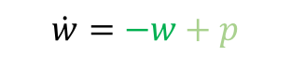
Developing a Probabilistic Computation Unit (PCU)
As an initial step, we want to show that synaptic weights in the Latigo chip can model the conditional probability between two random variables
Hypothesis: STDP and spike delays combine to create a conditional probabilistic computation unit
Forcing A→B and inhibiting the decay path adds back a growth term
$$\dot{w}$$
$$\dot{w}=−w+p$$
$$p$$
$$w$$
Combination of exp. decay and constant growth results in a stable fixed-point at a location we control

Slide 8
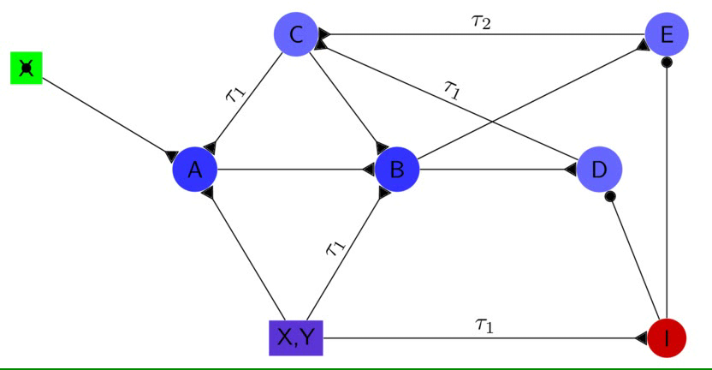
Weight Decay Mechanism

Slide 9
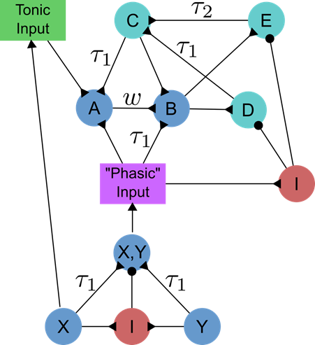
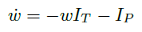
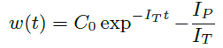
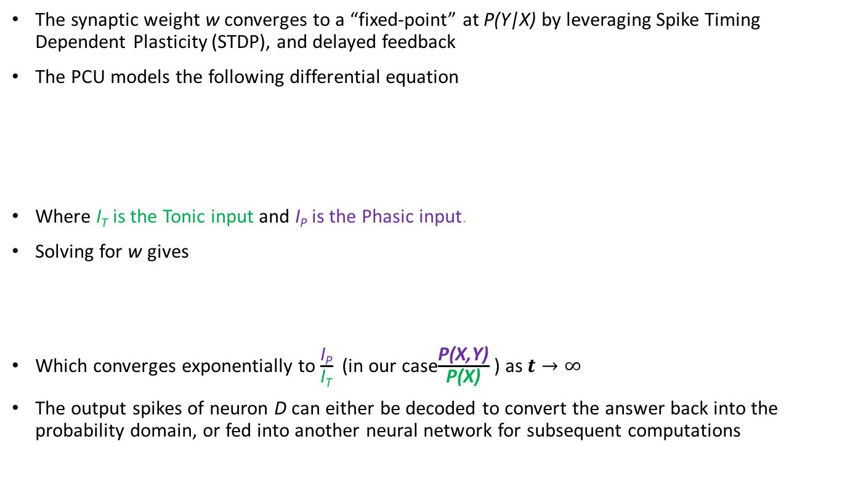
Probabilistic Computation Unit (PCU)
The synaptic weight w converges to a “fixed-point” at P(Y|X) by leveraging Spike Timing Dependent Plasticity (STDP), and delayed feedback
The PCU models the following differential equation
Where I_{T} is the Tonic input and I_{P} is the Phasic input.
Solving for w gives
Which converges exponentially to $\frac{\text{I}\text{P}}{\text{I}\text{T}}$ (in our case$\frac{\text{P}\text{(}\text{X}\text{,}\text{Y}\text{)}}{\text{P}\text{(}\text{X}\text{)}}$ ) as $t→∞$
The output spikes of neuron D can either be decoded to convert the answer back into the probability domain, or fed into another neural network for subsequent computations
PCU

Slide 10
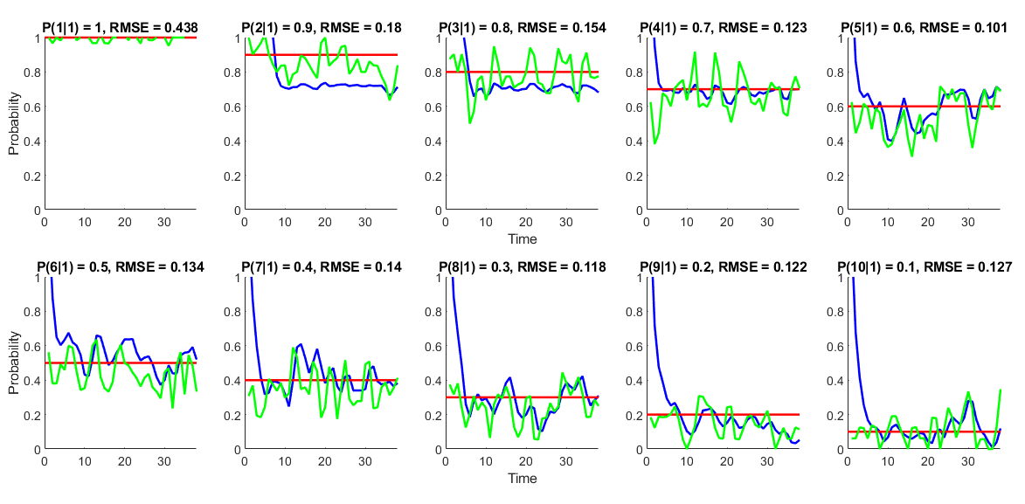
Results with Hardware Restriction
Red = P(Y|X) ground truth probability used for synthetic data generation, Green = Estimate of actual P(Y|X) spikes fed into the PCU, Blue = weight values
Current implementation shows some saturation

Slide 11

Composition and Scaling of PCUs
We can connect this functional unit to form networks
The networks learn conditionals in first stage
In second stage, weights are fixed and we can read out various conditionals
Modular composition enables neuromorphic compiler
C
C
C
C
x
z
y
M
M
=
X
Y
Z
M
z
M
M
x
y
P(Y|X) P(X|Z)
The functional unit can be compiled into networks for higher order computations

Slide 12
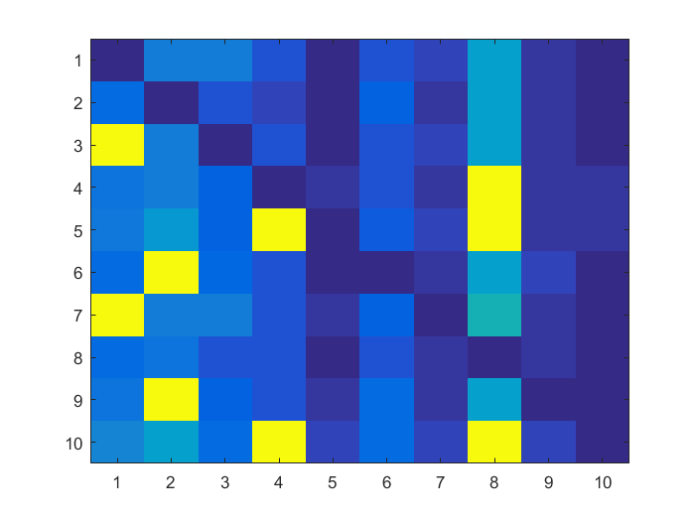
Structure Learning
Using a fully-connected network of PCUs, conditional structure can be extracted from data
Bayesian Graphical Model
Learned Conditionals
Learned Transitive Closure

Slide 13
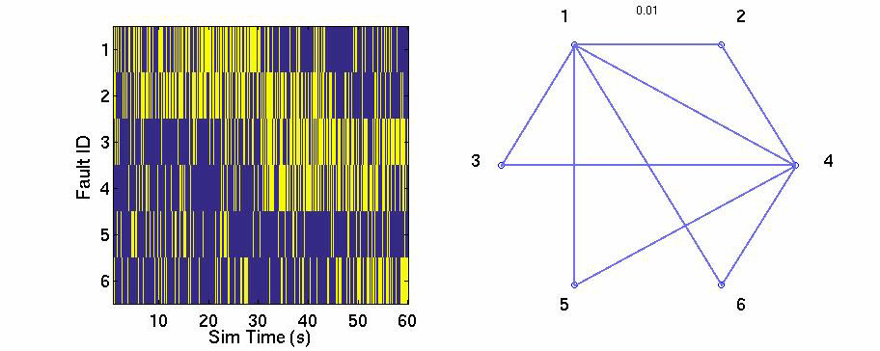
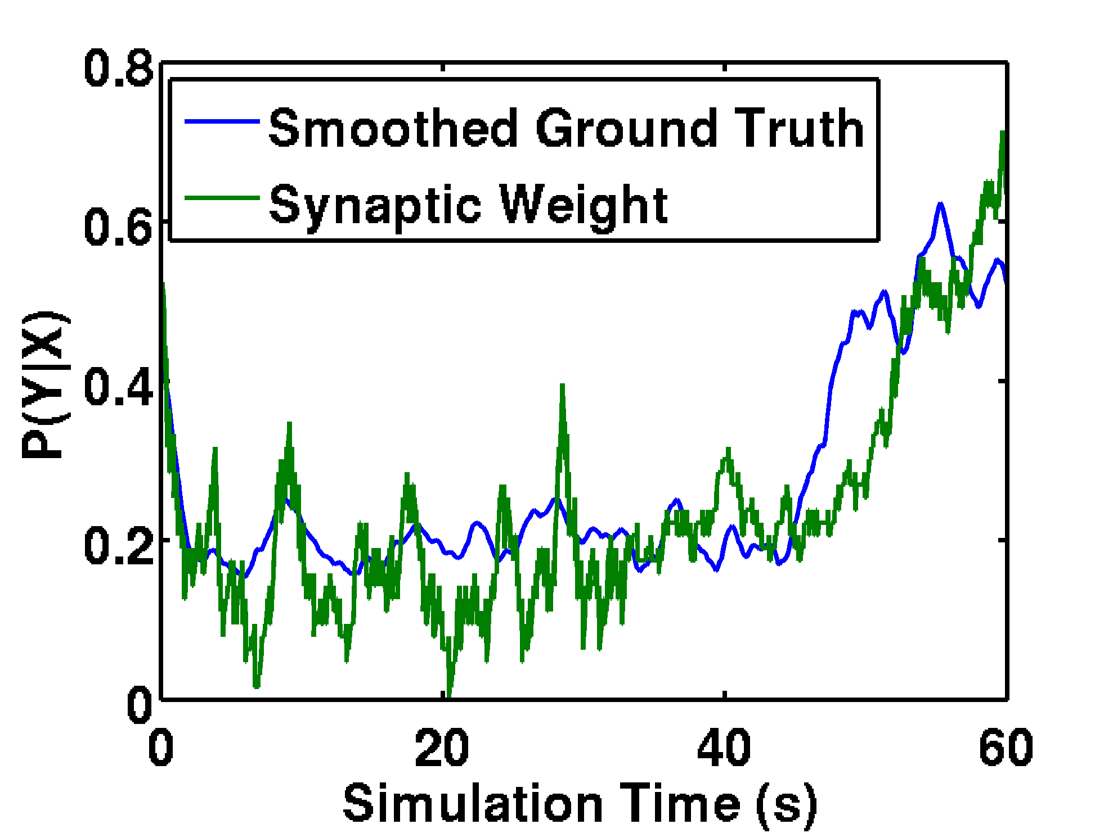
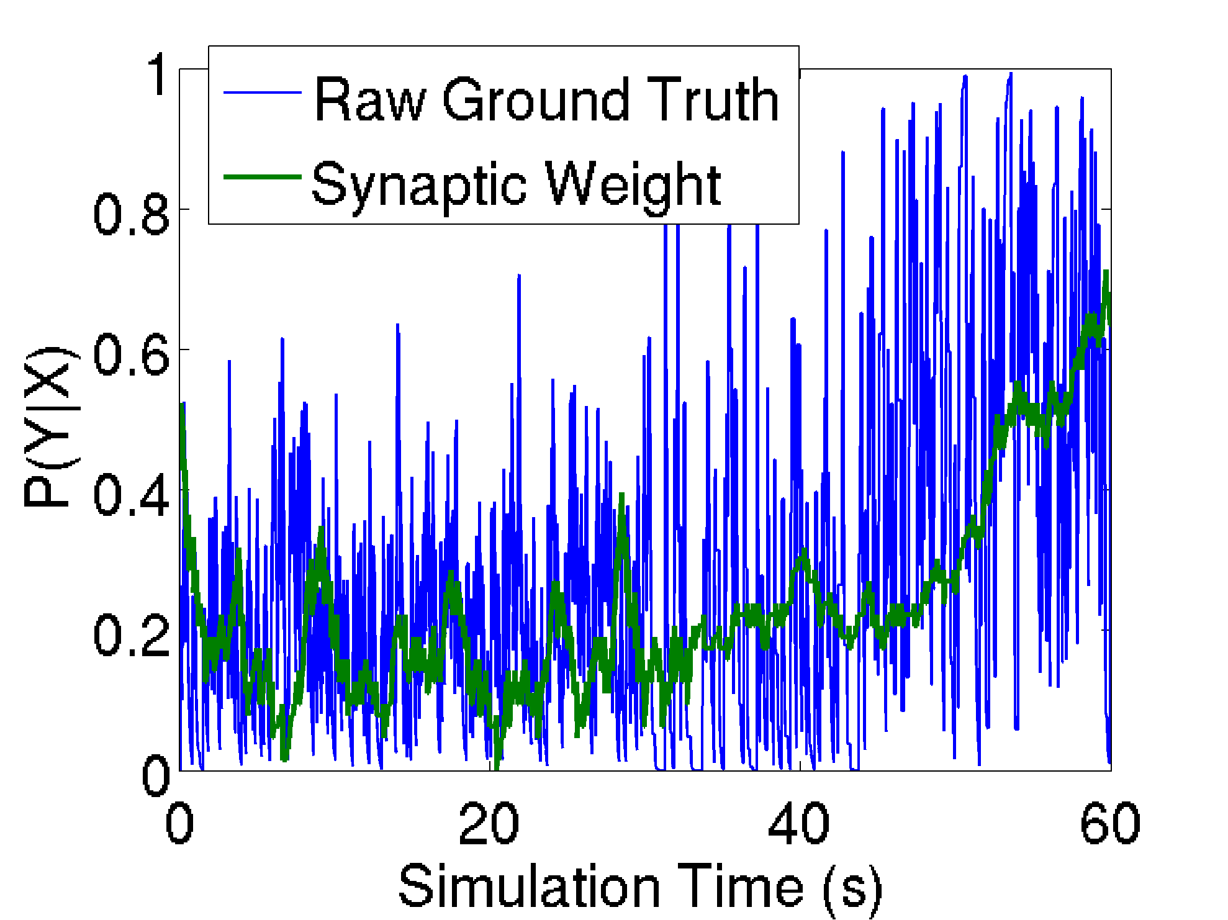
Fault Diagnostics - Simulation
Time series for P(6|1)
Using 6 simulated fault sources, learn conditional probability structure:
For readability, only faults 1 and 4 against others
Identifies conditional dependence over time
Demonstrates inherent smoothing ability
Method has also been applied to real aircraft fault messages
Synaptic weights track conditional structure

Slide 14
Thank You

